Slide 1
Clarification Without Filtration
Technical Meeting
MBAA-Rocky Mountain District
Thursday, June 23, 2011
Matt Bailey
Maint/Engr Mgr
Odell Brewing
Information and animations provided by and proprietary of GEA Westfalia

Slide 2
Summary
Odell’s Centrifuge History
Basic Theory of Separation
Centrifuge Operating Principles
Results

Slide 3
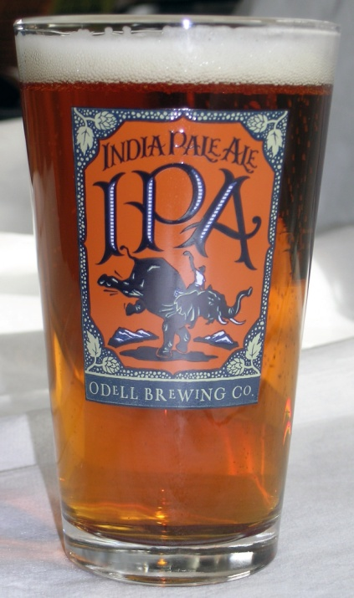
Odell’s Centrifuge History
Problem: Diatomaceous Earth (DE) filtration
  Hop forward beers caused many filtration issues
    More Breakdowns
    Higher beer loss
    High DE consumption
  Tried vertical and horizontal filters
    Both designs had pros and cons
    Issues with loss and breakdowns still present
  DE consumable cost is high
  Dangerous to co-workers
Concept
  Eliminate DE filtration and achieve acceptable clarity
Research/Test
  2009: First discussion with Westfalia at MBAA conference
  2010: Test Skid
    Had mixed results, but showed much promise for being undersized for our needs
    Blind taste panel preferred flavor, aroma, and mouth feel to DE filtered beer
    Consulted with New Belgium, Deschutes, Stone, Boulevard, and Ninkasi to make educated leap of faith

Slide 4
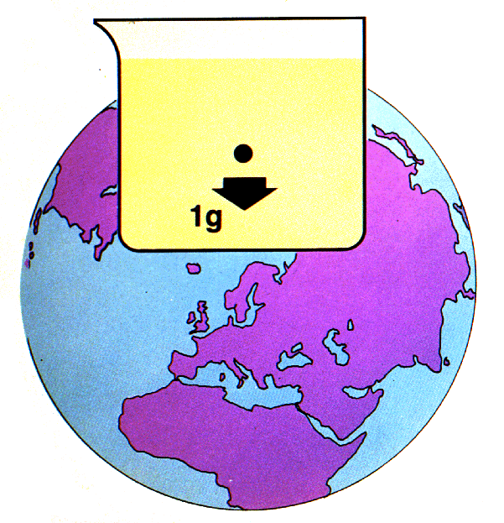
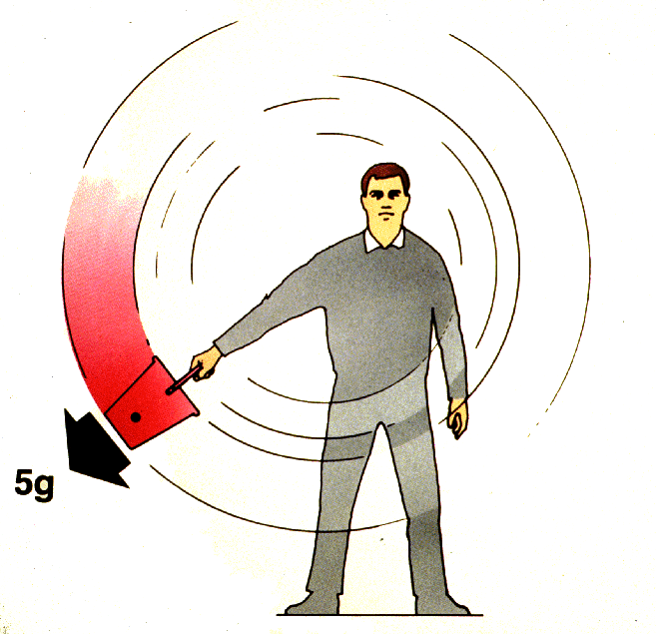
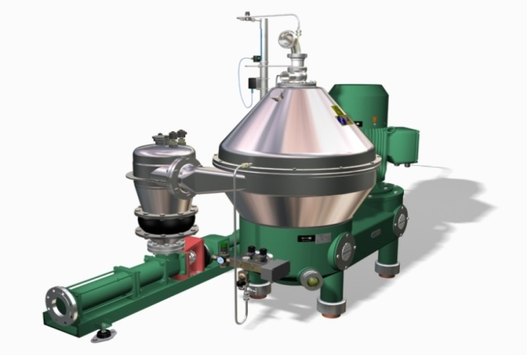
Theory
Separation is defined as the process of separating two liquids with the simultaneous removal of solids
8,000 + g

Slide 5
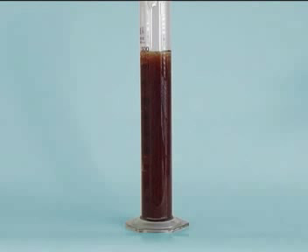
Theory…
All separation methods that use gravity or centrifugal force occur because there is a density difference between the continous media (Beer) and the media that is to be seperated (hops, yeast, etc).
The density difference allows for settling and stratification
Stokes law is a fundamental law of physics that applies to settling
The speed (or Velocity) that a particle will settle is calulated by:
D² * (d1-d2)
18 ή
Vs =
* g
D = size of particle
(d1-d2) = density difference
Centrifuges increase the particle settling velocity

Slide 6
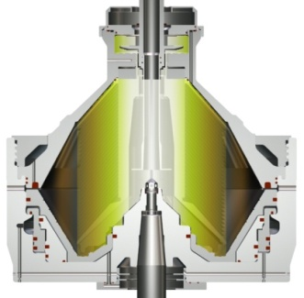
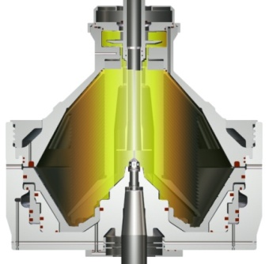
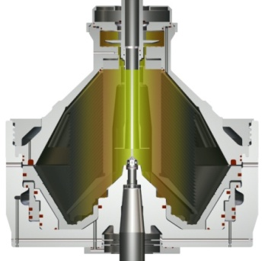
Operating Principles
All solids with a higher density will sink to bottom of a vessel over time
Centrifuge bowl spins at 4800 rpm and creates 8000 gs of force to create a layering effect
In the Centrifuge solids are thicker at the outside edges and the liquid is free of solids in the center

Slide 7
Settling Time Stats…
Settling Tank
Particle Size Settling Time
5 meters
0.3 mm 1 day
0.003 mm
27.5 years
Centrifuge
Particle Size Settling Time
0.3 mm 0.001 secs
0.003 mm
11.41 secs

Slide 8
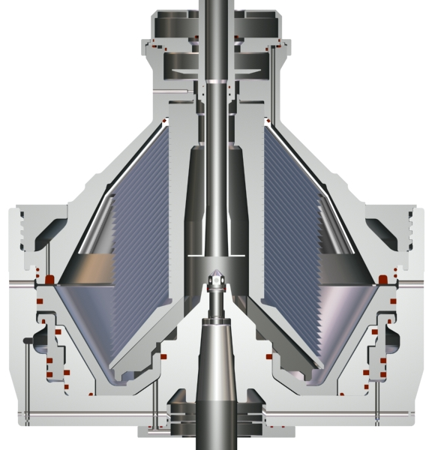
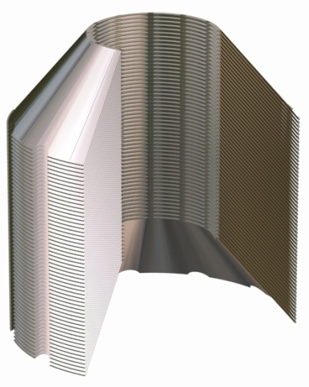
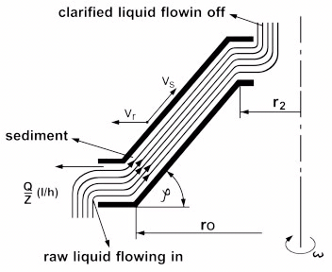
Centrifuge Bowl
Centrifuge disc stack creates large surface area to reduce solids from exiting into product stream
Disc stack effective surface area is equal to 30 soccer fields

Slide 9
Centrifuge Operation
GEA Animations\Video\SC 70 Flow Path w Solids Build up_mpeg2video.mpg

Slide 10
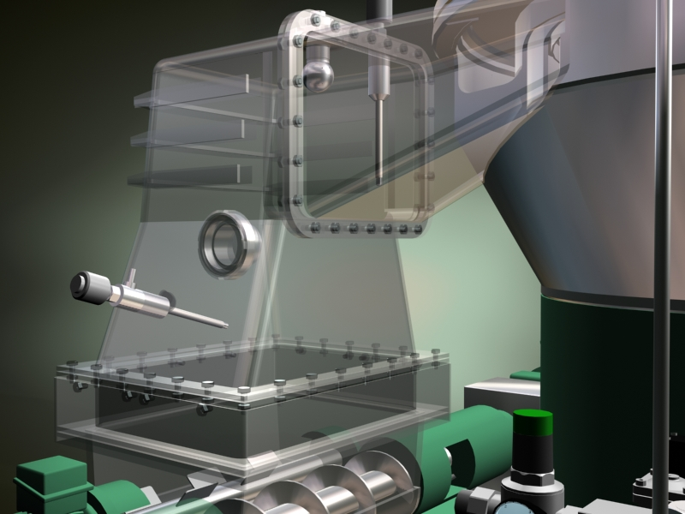
Solids Ejection
Centrifuge will eject solids to maintain clarity based on either turbidity or time or both
For highly hopped beers and processing tank bottoms, in line turbidity meters will detect the solids load in the bowl and cause an ejection
Solids are pumped out via a progressive cavity pump

Slide 11
Solids Animation
GEA Animations\Video\SC 150 Chute w Sludge_mpeg2video.mpg

Slide 12
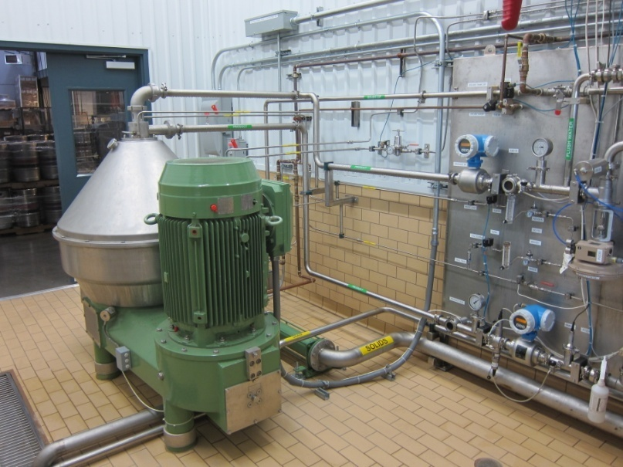
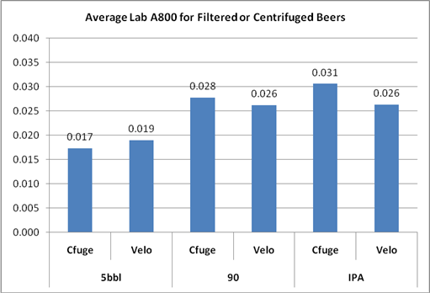
Odell’s Results
Started solely centrifuging all production beers in March 2011
  Only filtered beer is Double Pilsner
Dissolved Oxygen pick up is undetectable
Cell count carry over is zero
Haze comparison
Yield improvement
  Across all brands ~4%
  Hop-forward beers ~ 5.5 – 6 %

Slide 13
Observations
Chill down time is extremely helpful with hoppy beers
Blending cone during a run helps with cone processing for improved yield
Most importantly we feel beer quality has improved:
  “Since the beer is never passed through a filter media, the essential hop oils and fine proteins are left in tact. We have noticed improved hop flavor and aroma, as well as improved body and mouthfeel”
    Joe Mohrfeld #5 most eligible Bachelor Brewer by drinkwiththewench.com

